Slide 1

Queens NY Restaurant Inspection
For January 2021- December 2022
Timothy Yip

Slide 2

Motivation
Questions
I love trying new cuisines and restaurants.
Queens, NY is the most diverse county in the United States. ¹
Queens residents are said to speak over 130 languages and represent over 120 countries. ²
What’s the most inspection by cuisine in Queens?
What zip code had the most inspection in Queens?
Which cuisine has the best and worst score in Queens?
Üter Zörker

Slide 3
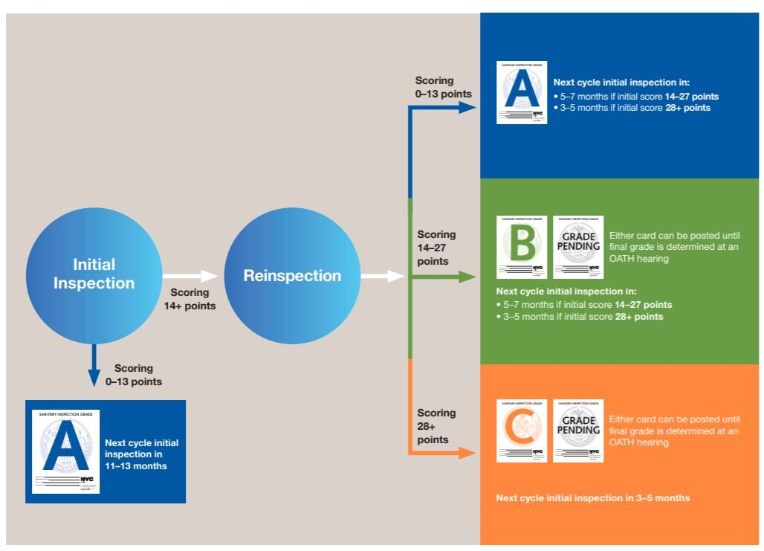
NYC DOHMH Inspection Process
Restaurant receives initial inspection. Points are assigned if any violation are found
If < 14 points a restaurant receives a “A” and will be inspected in 12 months
If >14 the restaurant will be reinspected in 7+ days
The score from reinspection will determine the grade posted
If scored more than >14 again they have an option of posted “B” or “C” or “Pending”

Slide 4
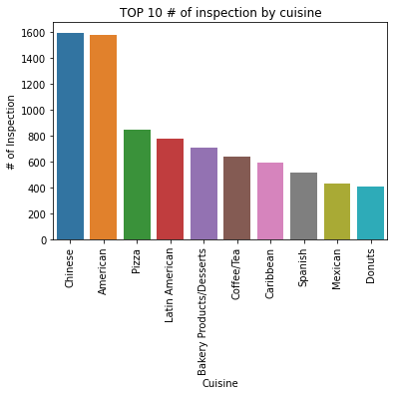
Top 10 # of inspection by cuisine
Cuisine Description | # of Inspection
Chinese | 1595
American | 1577
Pizza | 847
Latin American | 781
Bakery Products/Desserts | 707
Coffee/Tea | 636
Caribbean | 594
Spanish | 513
Mexican | 431
Donuts | 408

Slide 5
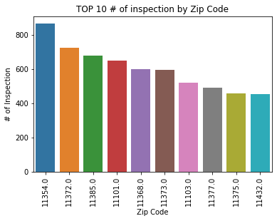
Top 10 # of inspection by Zip Code
Zip Code | Grade
11354 - Flushing | 863
11372 - Jackson Heights | 723
11385 - Glendale | 679
11101 - Long Island City | 649
11368 - Corona | 597
11373 - Elmhurst | 595
11103 - Astoria | 521
11377 - Woodside | 490
11375 - Forest Hills | 457
11432 -Parts of Jamaica | 452

Slide 6
Worst 20 Average by cuisine
 | Cuisine | Average Score
1 | Filipino | 32.604938
2 | Southeast Asian | 28.300000
3 | Bangladeshi | 28.162162
4 | African | 23.476190
5 | Chinese/Japanese | 23.000000
6 | Peruvian | 22.138686
7 | Pakistani | 21.705882
8 | Asian/Asian Fusion | 21.405738
9 | Portuguese | 21.266667
10 | Barbecue | 20.260870
 | Cuisine | Average Score
11 | Indian | 19.911504
12 | Bakery Products/Desserts | 19.708628
13 | Thai | 19.600000
14 | Latin American | 19.441741
15 | Spanish | 19.072125
16 | Korean | 18.832797
17 | Seafood | 18.615385
18 | Brazilian | 18.428571
19 | Jewish/Kosher | 18.107843
20 | Eastern European | 18.105263

Slide 7
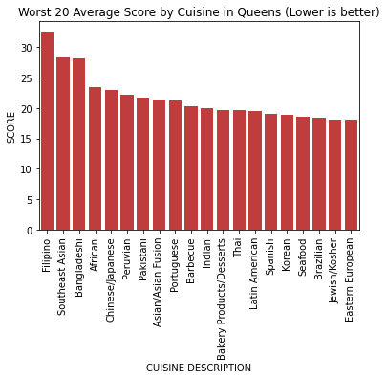
Worst 20 Average by cuisine

Slide 8
Best 20 Average by cuisine
 | Cuisine | Score
1 | Creole/Cajun | 0.000000
2 | Fruits/Vegetables | 0.583333
3 | Southwestern | 2.000000
4 | Scandinavian | 3.000000
5 | Vegan | 5.000000
6 | Polish | 6.250000
7 | Czech | 7.400000
8 | Chilean | 7.500000
9 | Donuts | 9.199017
10 | Not Listed/Not Applicable | 9.750000
 | Cuisine | Score
11 | Salads | 9.833333
12 | Soups/Salads/Sandwiches | 10.000000
13 | Indonesian | 10.000000
14 | Cajun | 10.125000
15 | Moroccan | 10.571429
16 | Sandwiches | 10.649718
17 | Australian | 11.000000
18 | Tapas | 11.000000
19 | Soul Food | 11.222222
20 | Irish | 11.270000

Slide 9
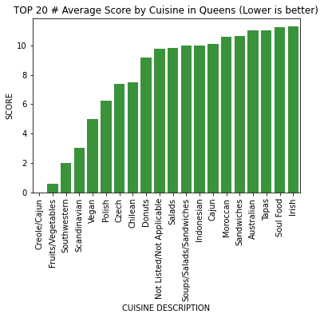
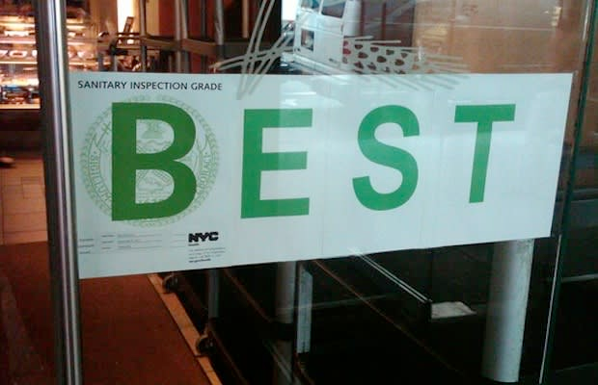
Best 20 Average by cuisine

Slide 10
Conclusion for Queens Restaurant Inspection 2021-2022
Chinese Restaurants was the most inspected at 1595 inspections.
Flushing zip code 11354 was the highest amount of inspection of 863 inspections.
Worst Average score among cuisine was Filipino of 32.6.
Best Average score Creole/Cajun of 0.
Looking at this data it will not influence my decision making for looking at restaurants
*If I were to look at this data again I would look at the rate of inspection for restaurants since restaurant can get multiple inspections a year. This could have skewed some of the data reported.

Slide 11
Sources
NYC Health
The Inspection Process - NYC Health
NYC Restaurant Inspection Scores
Letter Grading for Restaurants - NYC Health
DOHMH New York City Restaurant Inspection Results | NYC Open Data
Queens is crowned nation's most diverse large county
Queens: The New York Borough That’s The Most Diverse Spot in the US

